Slide 1


Internet Of Thinking

Slide 2

Agenda
Introduction to IOT
Where does it stand today?
Prototype
Risks & Mitigation
Scope of the prototype
Opportunities for Deloitte

Slide 3
INTRODUCTION
Internet Of Thinking
ENABLING INTELLIGENCE FOR THE NEXT GENERATION OF TECHNOLOGY DEMANDS A BALANCE OF CLOUD AND EDGE COMPUTE TO DELIVER INTELLIGENCE EVERYWHERE !
Internet Of Thinking:
Driving revolutionary technology.
Intelligence at the edge.
Ties different components together to provide edge devices with the computing power.
So why we need IOT?
Less Computation Time
Flexible
Real-Time
Interactive
What can be done to make the efficient use of the technology?

Slide 4
Associated Risks & Mitigation
Risks on the edge:
Only a subset of data is analyzed on the edge, discarding raw information and providing incomplete insights.
Probability of data loss is high as whole data is processed on the device itself, making data recovery difficult.
Inefficiency in computation when data volumes are increased
Physical Security Risks:
Default and Weak Credentials
Boot protection
Its mitigation:
To maintain data integrity, sensitive data should be moved from edges to cloud with encryption using an edge orchestrator.
Patching or upgrading the firmware of edge devices with the latest updates to prevent attacks.
As data flows from device to data collection system, it must be protected. Personally identifiable information (PII) should be separated from other data elements using Multi-level Security (MLS)

Slide 5
Associated Risks & Mitigation
On the channel:
Software vulnerabilities pose network security risks.
Unencrypted/unsecure wireless network access while on the move.
Irregular software updations due to ignorance of user.
Cyber attacks:
Man in the middle
DDOS/DOS
SQL Injection
On the cloud:
Unauthorized access to customer and business data.
Risks related to lack of control.
Internet-Accessible Management APIs may be compromised.
Malware infections may unleash a targeted attack.
Mitigations on the cloud:
Periodic testing to verify integrity of back up.
Using DLP solutions for data security.
Vulnerabilities are documented and widely deployed making targeting the devices easy. Organizations should track all open source component and version dependencies.
Mitigations on the channel:
Medium of data transmission should be secure so that Man-in-the-Middle and similar attacks can be avoided. Edge gateways provide:
Security via encryption & X.509 certificates
Protocol translator converting disparate convergent data into a single protocol such as Messaging Queuing Telemetry Transport (MQTT).
For DOS/DDOS:
Whitelisting legitimate IP addresses or blocking ones from known attackers
Rate limiting
Filter requests upstream before they reach the target network

Slide 6
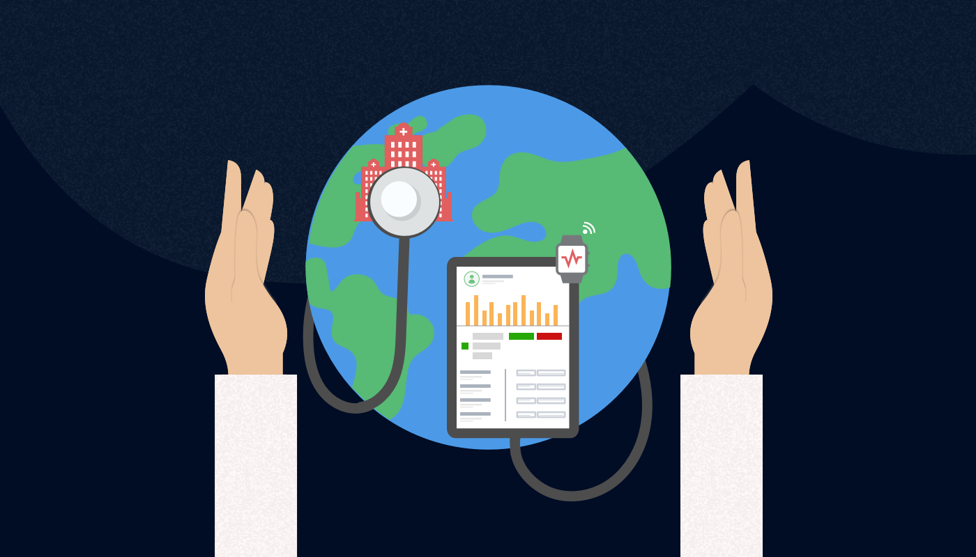
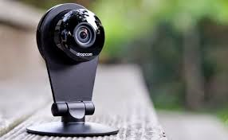
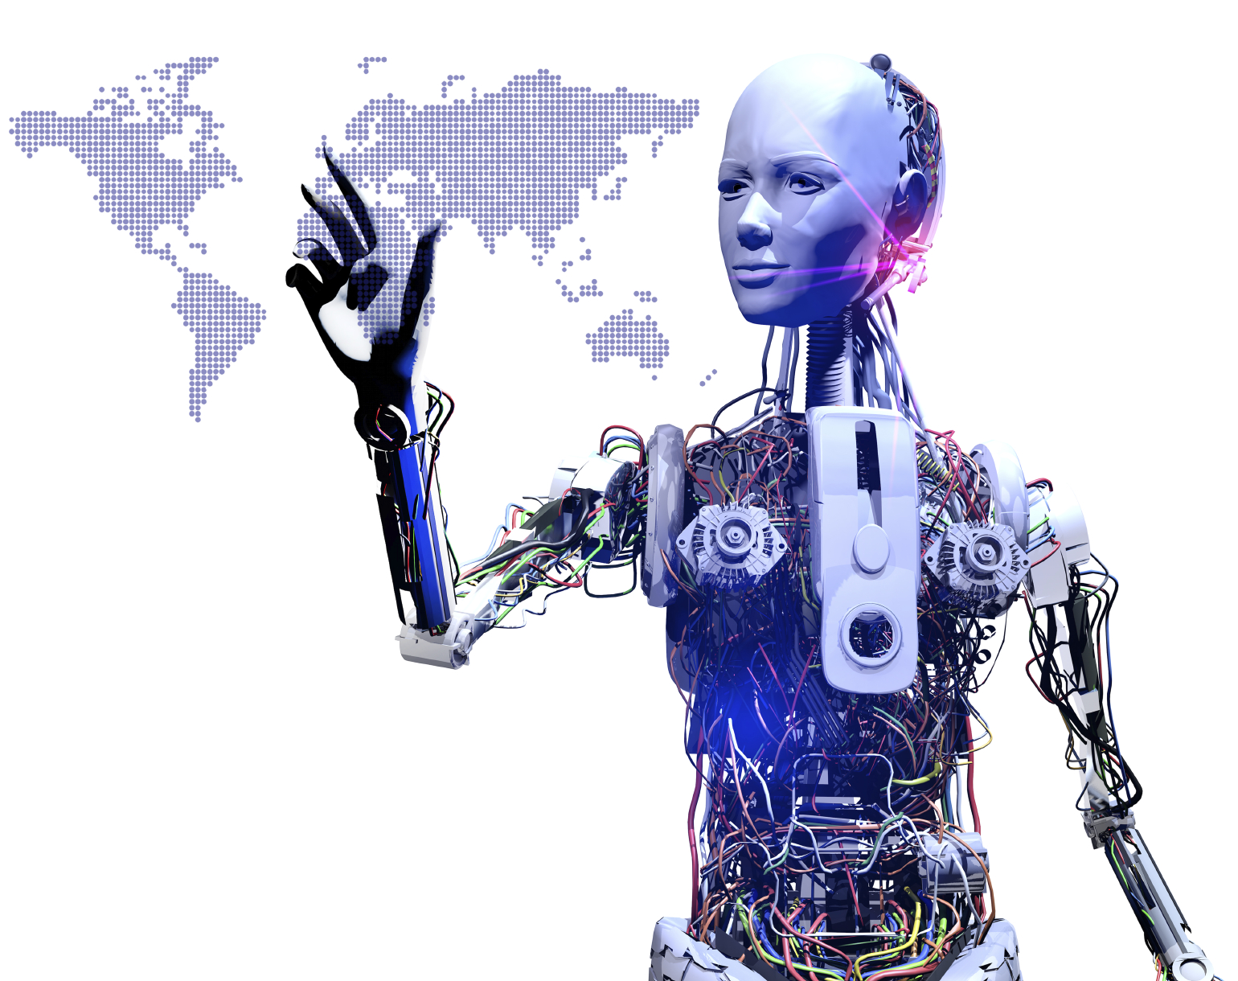
The first thing to recognise about the shift to the internet of thinking is that our physical world is transforming into a range of increasingly intelligent environments
The first thing to recognise about the shift to the internet of thinking is that our physical world is transforming into a range of increasingly intelligent environments
Current Key Applications: Industries Being Affected
Our physical world is transforming into a range of increasingly intelligent environments, hence requiring the need to shift to Internet Of Thinking.
Health care
A wearable fitness band is an example of a basic edge solution. It can locally analyze data like heart rate or sleep patterns and provide recommendations without a frequent need to connect to the cloud. Other examples can include pedometers, pharmacogenomics, etc.
Retail
Uses edge devices to do everything from creating better in-store customer service by deploying tablets to employees, using sensors to monitor temperature-sensitive foods, or even ambitious pilots that uses myriad devices to power a store with no checkout lines.
Precision Agriculture
Uses sensors and connected farm equipment to improve yields ,save cost and become more sustainable.
Manufacturing:
Deploying robots that can “learn on the job” across production lines for real time customization, more efficient boxing and packaging, and more.
Oil and gas:
Companies are using remote sensors and devices like drones to monitor pipelines for predictive maintenance, map routes, or improve the work of field technicians.
Consumer Industry
Requires large computing power to respond to users action and update the state of AR environment , by using edge computing in AR applications energy usage of all devices can be reduced.
Surveillance Systems
It helps to imbue the device itself with intelligence, so that analytics can happen at the source. This reduces the lag time and bandwidth needs, improves security, by removing the need to send potentially sensitive data to the cloud for analysis.
Robotics
Processing and computation together are bringing thinking into play i.e. they can understand the difference between a part that is broken and one that is out of order and decide whether to discard the part, call a supervisor, or work out their own solution.

Slide 7
Future Scope of IoT
These next generation solutions are not isolated to a few industries, but are emerging everywhere. Soon the edge will matter to every company!
More hardware orientation than s/w unlike the expected trend
Smarter devices, and cities
Routers will become secure
Smarter security devices, less passwords, easier but more secure accesses

Slide 8
About Deloitte Deloitte refers to one or more of Deloitte Touche Tohmatsu Limited, a UK private company limited by guarantee (“DTTL”), its network of member firms, and their related entities. DTTL and each of its member firms are legally separate and independent entities. DTTL (also referred to as “Deloitte Global”) does not provide services to clients. In the United States, Deloitte refers to one or more of the US member firms of DTTL, their related entities that operate using the “Deloitte” name in the United States and their respective affiliates. Certain services may not be available to attest clients under the rules and regulations of public accounting. Please see www.deloitte.com/about to learn more about our global network of member firms. Copyright © 2018 Deloitte Development LLC. All rights reserved.

